Slide 1
Enhancing Reports Using the Data Model: Queries and Groups
Notes:
Schedule: Timing Topic
<xx> minutes Lecture
<xx> minutes Practice
<xx> minutes Total

Slide 2
Objectives
After completing this lesson, you should be able to do the following:
  Describe the Data Model objects
  Modify query properties
  Modify the report hierarchy
  Change the order of data in a group
  Eliminate data from a report
Notes:
Lesson Aim
<Enter lesson aim here.>

Slide 3
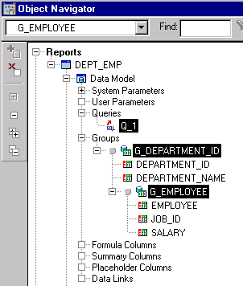
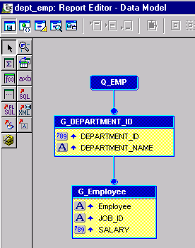
The Data Model Objects

Slide 4
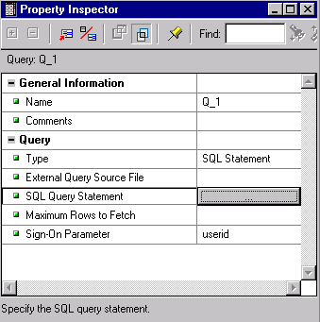
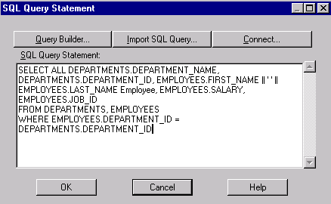
Modifying Properties of a Query

Slide 5
Modifying Properties of a Query
  Modify SQL query statement:
    Add, rename, or delete columns
    Use column and table aliases
    Remove or modify schema name
  Syntax error checks occur when:
    Exiting SQL query statement
    Compiling or executing a report

Slide 6
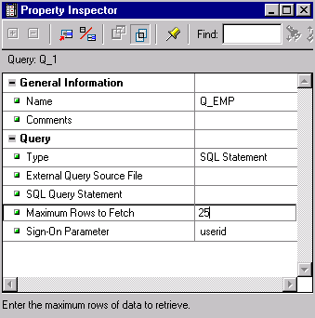
More Properties
Aid maintenance and testing:
  Rename queries in complex reports
  Add comments to describe queries:
    Use the Comment property
    -- comment for single lines
    /*comment*/ for multiple lines
  Set Maximum Rows to Fetch
  to restrict data

Slide 7
Applying Changes
Update the paper layout and Web source to reflect changes in the Data Model.
  For paper reports:
    Select Report Wizard.
    Alter the necessary tabbed pages.
The Wizard destroys previous layout and creates new objects.
  For Web reports:
    Select the Report Wizard and navigate through each of the tabbed pages, reselecting the desired options.
    or
    Edit the Web source manually.

Slide 8
Groups
Groups determine hierarchy and frequency.
  Wizard creates default groups.
    Default naming conventions
    You can change query name.
    You can change group name.
  Developer-created groups for:
    Control break reports
    Complex matrix reports

Slide 9
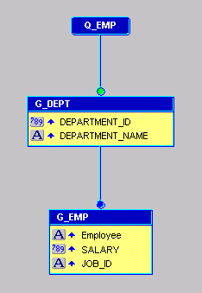
Group Hierarchy
1
2

Slide 10
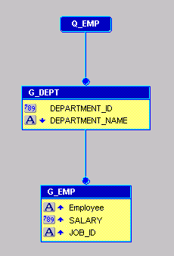
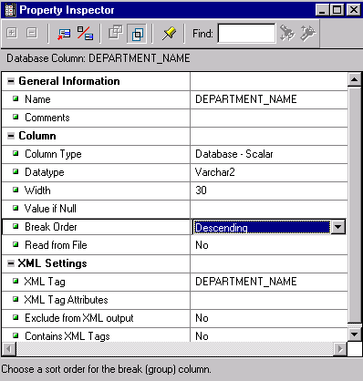
Ordering Data in a Group
1
2
3

Slide 11
Query Modifications
In a break report, data order is determined by:
  Break order columns in the break groups
  Columns that you specify in the ORDER BY clause
SELECT d.department_id, d.department_name, e.last_name...
FROM employees e, departments d
WHERE e.department_id = d.department_id
ORDER BY 2, e.salary

Slide 12
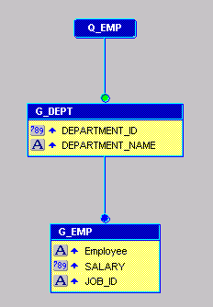
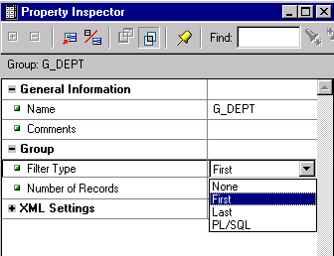
Filtering Data in a Group

Slide 13
Using a Packaged Filter
Reports Developer provides two packaged filters:
  First: Retrieves the first <n> records for the group
  Last: Retrieves the last <n> records for the group

Slide 14
Summary
  In this lesson, you should have learned how to:
  Identify Data Model objects
  Modify query properties
  Modify the report hierarchy by creating additional groups
  Filter data in a group

Slide 15
Practice 8: Overview
  Modifying report hierarchy
  Restricting records in a query
  Restricting records with a packaged filter

